Slide 1
ERASMUS
Committee Meeting
16 January 2020
2013
2016
Notes:
21:47
AGÜ Gençlik Fabrikası
Gençler için gençlerle birlikte daha iyi bir topluma...
Türkiye’de bir ilk olan Gençlik Fabrikası:
• gençleri eğiten,
• yaratıcı ve girişimci olmaya teşvik eden,
• gençlere yaşama dair beceriler kazandıran,
• uluslararası vizyon katan,
• gençlerin toplumsal hayata katılımını sağlayıp bir arada öğrenmenin ve üretmenin keyfine vardıran,
• ulusal ve uluslararası boyutta faaliyet gösteren öğrenen odaklı bir yapıdır.

Slide 2
Agenda Items
Presentations of applicants
Discussion on the selection of staff for the new term project
Discussion on the next plans and meetings
2013
2016

Slide 3
Staff Mobilty@AGU
Department | Teaching | Training
Architecture | 3 | 0
Business Administration | 7 | 0
Civil Engineering | 1 | 0
Computer Engineering | 2 | 3
Electrical and Electronics | 2 | 4
Industrial Engineering | 0 | 1
Mechanical Engineering | 2 | 1
Economics | 6 | 2
International Office | 0 | 5
Educational Sciences | 1 | 3
School Of Languages | 0 | 4
Political Science and Public Administration | 0 | 1
2013
2016

Slide 4
Staff Mobilty@AGU 2019-2021
 | Number | Dates
Teaching Mobility | 11+ 2 left from previous project until 2020 Total: 13 | Until 2021
Training Mobility | 3 | Until 2021
2013
2016

Slide 5
New Applications
Name | Department | Experience | Country | Institution | Dates | Mobility Type
İ. Alper İşoğlu | Bioengineering | 7 years | Germany | FH Münster | March 2020 | Teaching
Kutay İçöz | Electrical and Electronics Engineering | 6 years | Germany | Physical Intelligence Department | 22-28 March 2020 | Training
Niğmet Uzal | Civil Engineering | 7 years | Spain | Universidade de Santiago de Compostela | 23.03.2020-02.04.2020 | Training
Sedat Gülçimen | Civil Engineering | 8 months | Spain | Universidade de Santiago de Compostela | 23.03.2020-02.04.2020 | Training
Sinan Akyüz | Architecture | 7 months | Finland | University of Helsinki | 24.02.2020-01.03.2020 | Training
2013
2016

Slide 6
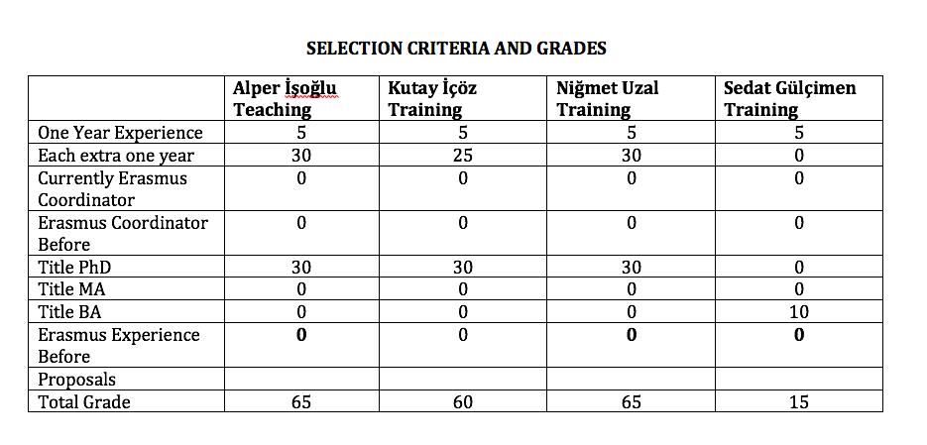
New Applications
2013
2016

Slide 7
Erasmus@AGU 2019-2021
Criteria for staff mobility:
At least one year of work experience at AGU: + 5 points
For each extra year of work experience at AGU: + 5 points
Currently, Erasmus Department Coordinator/Assistant: +10 points
Previous Erasmus Department Coordinator/Assistant: + 5 points
First time Erasmus applicant: +30 points
Academic personnel of Faculties/Schools with Ph.D. Titles: +30 points
Support academic personnel of Faculties/Schools with M.Sc./M.A Titles: +20 points
Support academic personnel of Faculties/Schools with B.Sc./B.A Titles: +10 points
2013
2016

Slide 8
Erasmus@AGU 2019-2021
Criteria for staff mobility:
Language Level 1 : + 40 points for KPDS/YDS .GE. 90, TOEFL IBT .GE. 108
Language Level 2 : + 30 points for KPDS/YDS .GE. 80, TOEFL IBT .GE. 96
Language Level 3 : + 20 points for KPDS/YDS .GE. 70, TOEFL IBT .GE. 84
Language Level 4 : + 10 points for KPDS/YDS .GE. 60, TOEFL IBT .GE. 72
Here .GE. stands for “Greater than or Equal to”. One can get a Language Point from only one of the Language Levels.
For presentation proposals that introduces the research activities, their budgets and the project based RA scholarships at AGU: +10 points
For presentation proposals that promotes the joint research collaborations between the two institutions: +10 points
For presentation proposals that promotes graduate studies at AGU for candidate grad students: +10 points
For presentation proposals that promotes academic exchange activities between the two institutions: +10 points
For presentation proposals that promotes undergrad and grad student exchange activities between the two institutions: +10 points
2013
2016

Slide 9
What’s next?
Next Call
Next Committee Meeting
2013
2016

Slide 10
Thank you for your participation!
2013
2016

